Slide 1

Internet of Things - Brokers
Maël CHARLOT - Hugo DELAY – Martin GROULT
18/10/2021

Slide 2
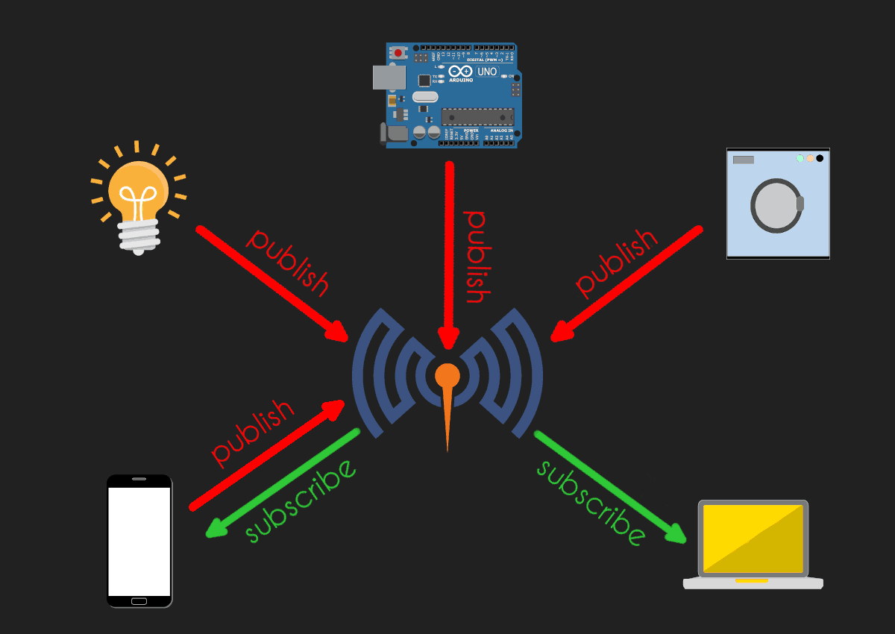
Introduction
MQTT Broker
Mosquitto
What does IoT broker do ?

Slide 3
Protocol types
MQTT
Publish - subscribre protocols
AMQP
CoAP
Request – response protocols

Slide 4
MQTT : Message Queue Telemetry Transport
Lightweight and scalable publish/subscribe IoT messaging protocol
Ideal for small devices that require efficient bandwidth and battery (sensors, smoke detectors, smart watches…)
New devices can be easily added without touching the existing infrastructure

Slide 5

Mosquitto
Cliquez pour ajouter du texte

Slide 6
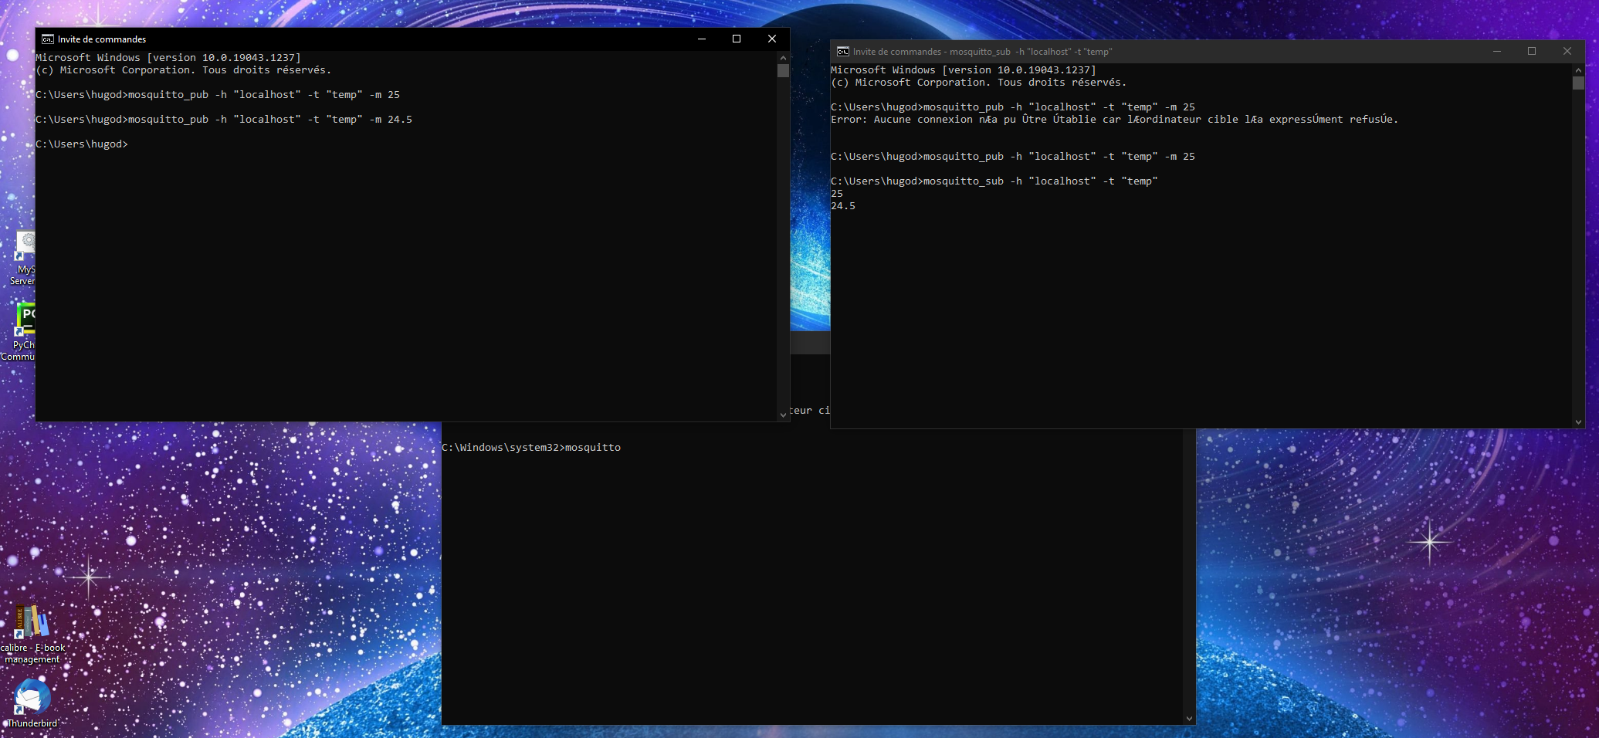

Local test
Publisher
Subscriber
Broker

Slide 7

Connected example with Mosquitto
Broker
Hugo
delay.myqnapcloud.com:25565
(Artzenheim, Haut-Rhin)
Publisher
Martin
(Strasbourg, Meinau)
Subscriber
Maël
(Bischheim)
Hugo

Slide 8
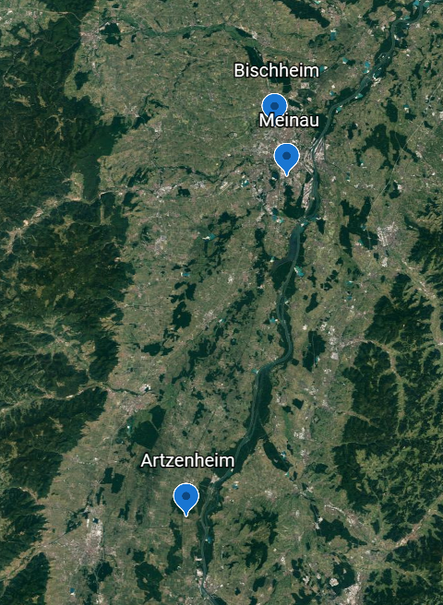
Geolocalisation

Slide 9
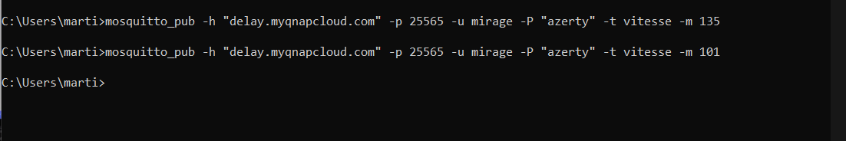
Publisher

Slide 10
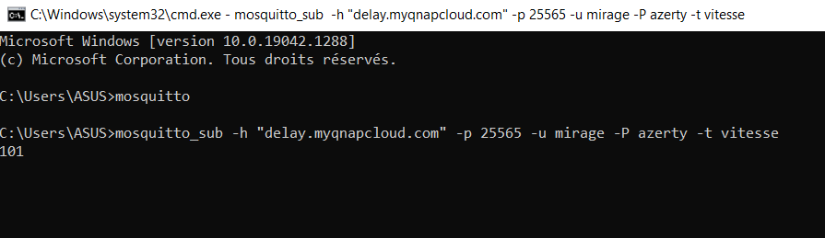
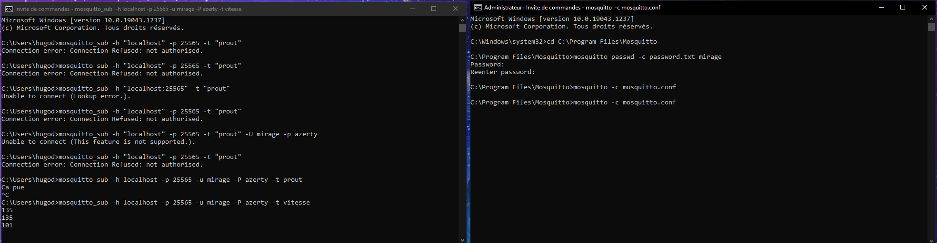
Subscribers

Slide 11
Broker

Slide 12
Broker's role
Manages server configuration (mosquitto.conf)
Manages usernames and authorizations if needed
Runs the server
Listens to subscribe request and publications (on specified port)
Forwards the topics to the concerned subscribers

Slide 13

mosquitto.conf

Slide 14
Users and passwords

Slide 15
CoAP Protocol
Request – response protocol
Developed by the Internet Engineering Task Force (IETF)
Extremely lightweight communications protocol stack suitable for resource-constrained devices
CoAP uses the GET, PUT, POST, and DELETE methods similar to HTTP

Slide 16
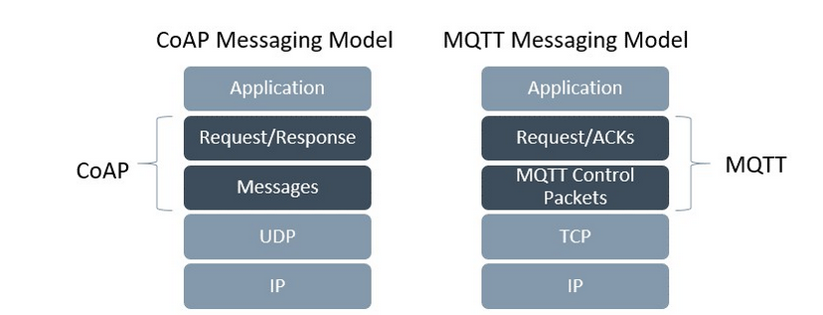

Slide 17
AMQP Protocol
Publish – subscribe protocol and request – response
Lightweight application layer protocol optimized for higher security and reliability
Easier provisioning and interoperability
Based on TCP transport protocol

Slide 18
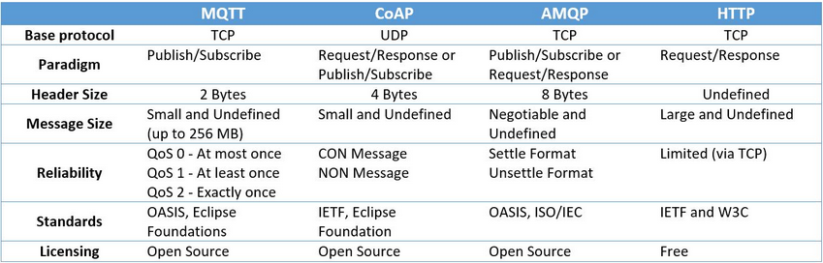
Differences between protocols

Slide 19
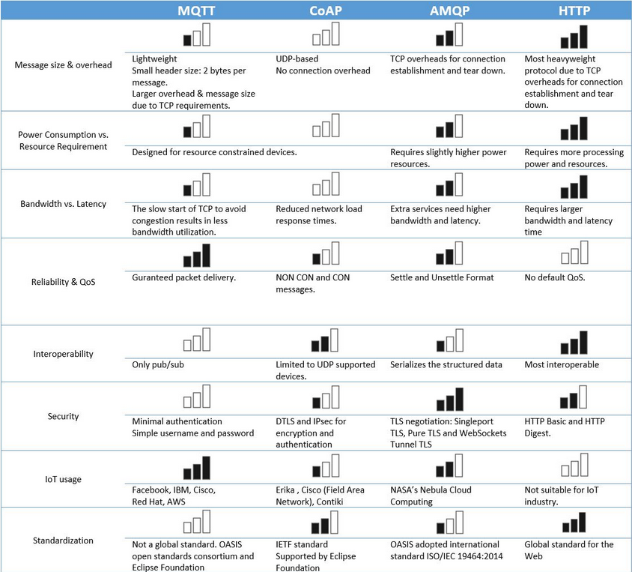

Slide 20

Practical exercise !

Slide 21
Data
https://mosquitto.org/files/binary/win64/mosquitto-2.0.12-install-windows-x64.exe
Username: mirage
Password: azerty
mosquitto_sub –h "delay.myqnapcloud.com" -p 25565 –u mirage –P azerty –t topicname
mosquitto_pub –h "delay.myqnapcloud.com" -p 25565 –u mirage –P azerty –t topicname –m message

